Slide 1
Covid 19 FACE MASK DETECTION
STUDENT NAME:
Mohammad ALShahrour
DOCTOR SUPERVISED:
DR.MASSA ALBAALI

Slide 2
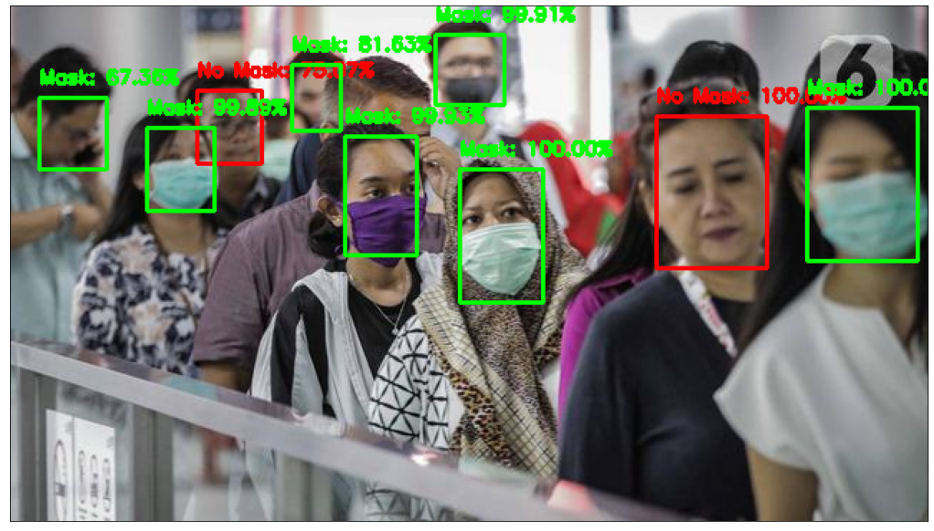

Slide 3
INTRODUCTION:
-According to the World Health Organization (WHO)’s official Situation Report – 205, coronavirus disease 2019 (COVID-19) has globally infected over 20 million people causing over 0.7million deaths
-To curb certain respiratory viral ailments, including COVID-19, wearing a clinical mask is very necessary

Slide 4
Problem:
-Many of people do not wear a mask and this is a mistake because the disease will spread among people and that will kill people
-to help companys,bus station,mall station and every gathering of people we need to solution spread of covid-19 disease we need TO DETECT WHO IS PUT MASK OR NOT

Slide 5
Solution:
-we solution this problem by using artificial intelligence TO DETECT WHO IS PUT MASK OR NOT
-With Face mask detection application involves in detecting the location of the face and then determining whether it has a mask on it or not
-we use face detection model and training with dataset(with mask image,without mask image) with cnn algorthims,tenser flow,keras, mobile.net v2 and Scikit-Learn.
-we help companys,bus station and mall station to detect people who is put mask or not

Slide 6
Dataset:
Two datasets have been used for experimenting the current method. Dataset 1 [16] consists of 1376 images in which 690 images with people wearing face masks and the rest 686 images with people who do not wear face masks. mostly contains front face pose with single face in the frame and with same type of mask having white color only.

Slide 7
Related work:
In face detection method, a face is detected from an image that has several attributes According to D. Meena and R. Sharan, "An approach to face detection and recognition", 2016 International Conference on Recent Advances and Innovations in Engineering (ICRAIE), pp. 1-6, 2016
According to the work reported in S. Ghosh, N. Das and M. Nasipuri, "Reshaping inputs for convolutional neural network: Some common and uncommon methods", Pattern Recognition, vol. 93, pp. 79-94, 2019.
Actually there no project similar in university to face mask detection because is newer project.

Slide 8
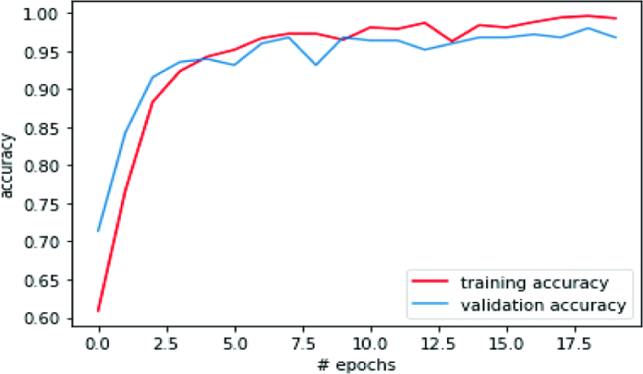
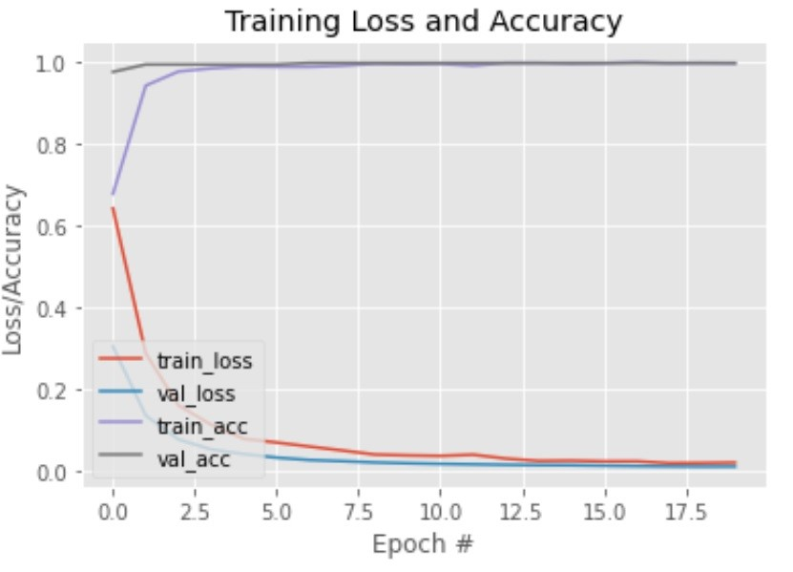
Related work :cont.

Slide 9
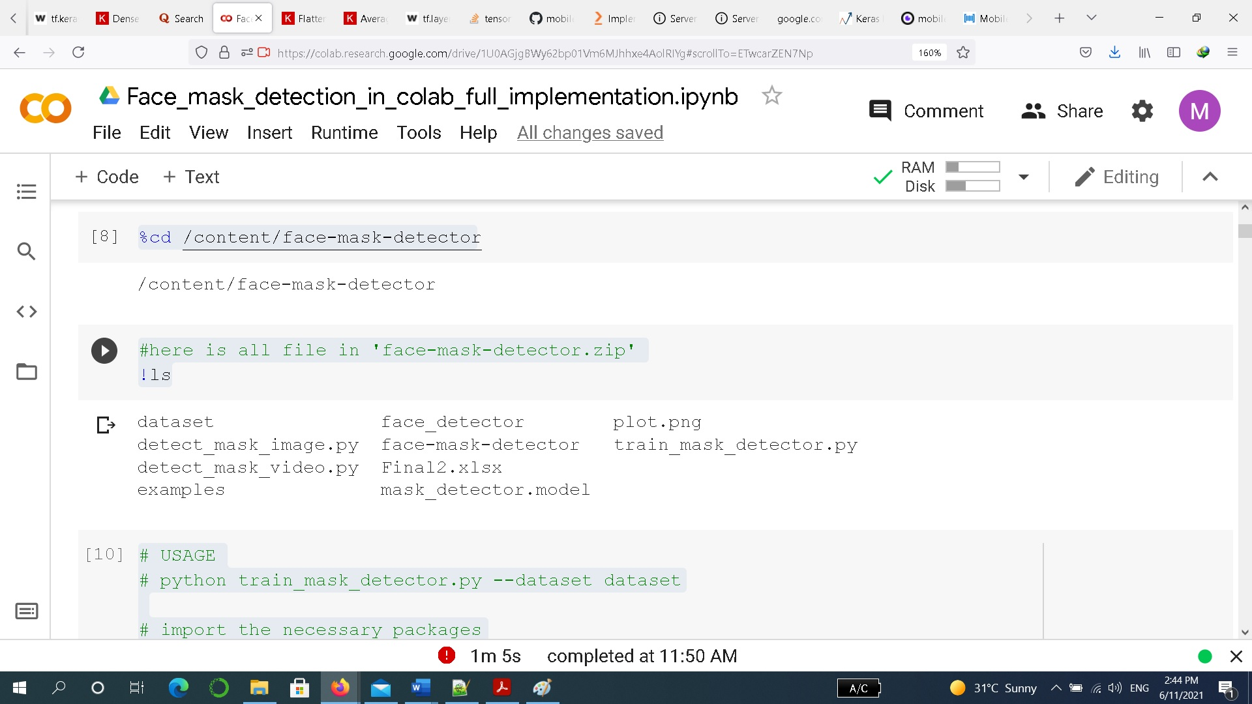
Screen shot of code:

Slide 10
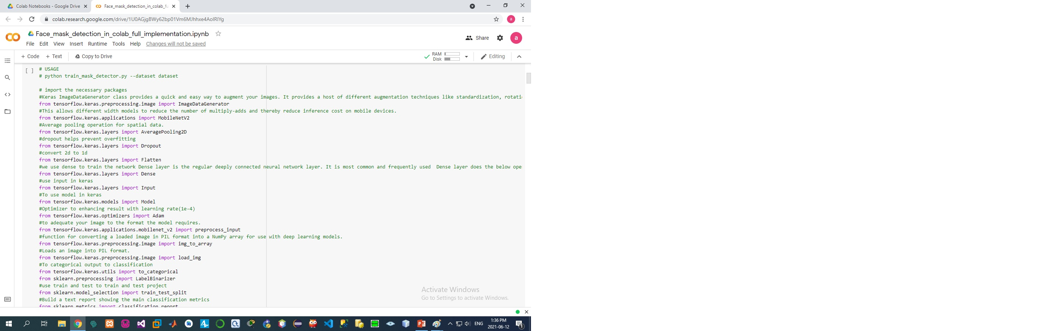
Screen shot of code:cont

Slide 11
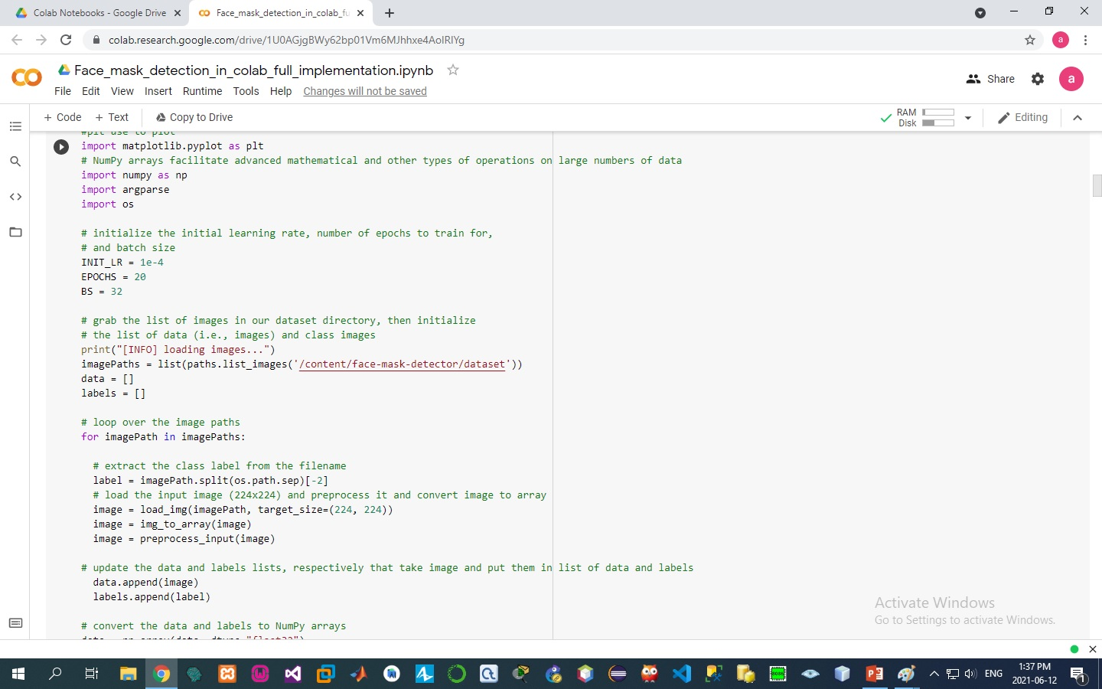
Screen shot of code:.cont

Slide 12
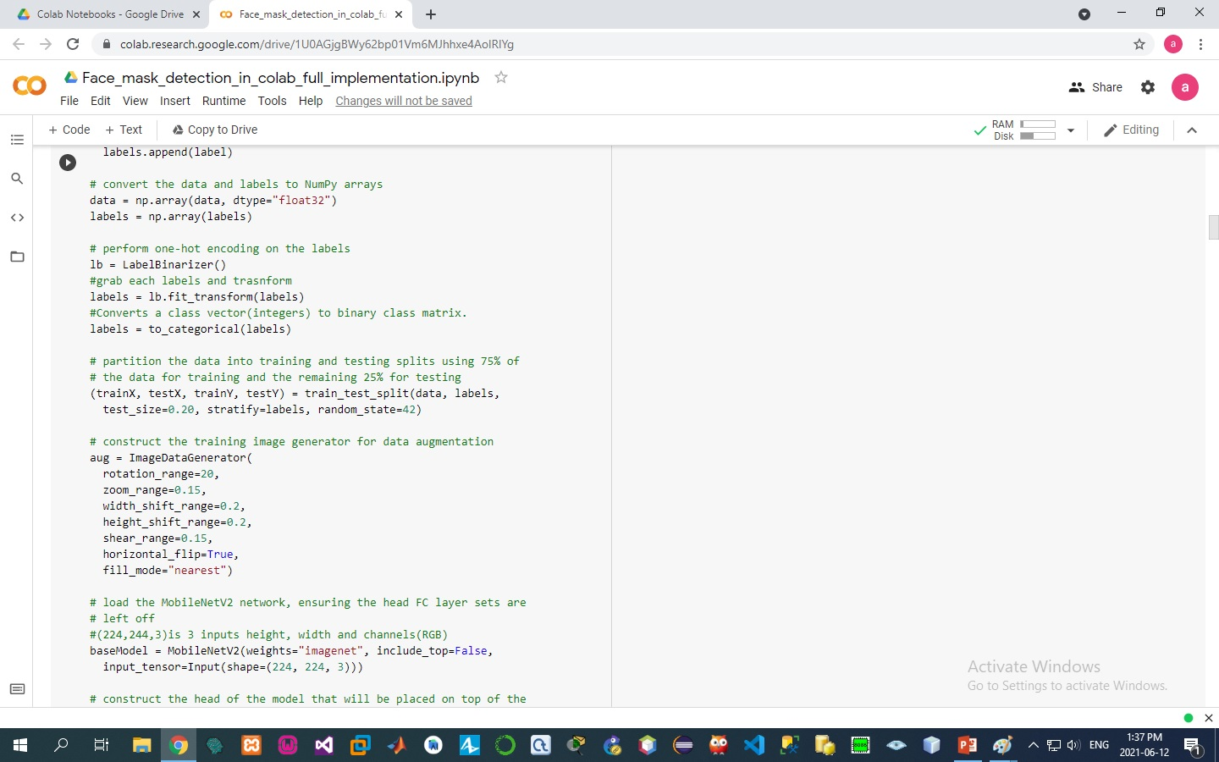
Screen shot of code:.cont

Slide 13
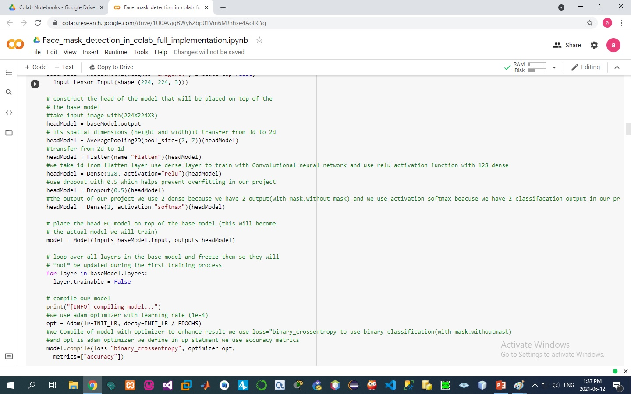
Screen shot of code:.cont

Slide 14
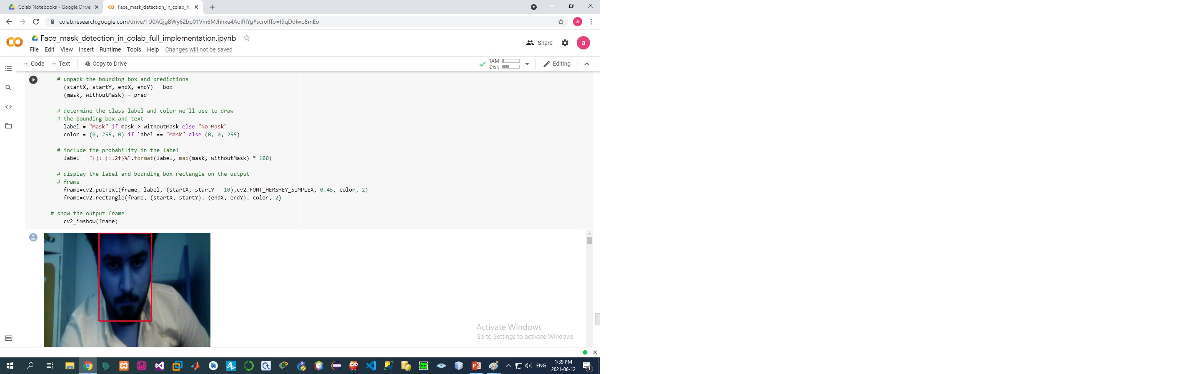
Screen shot of code:.cont

Slide 15
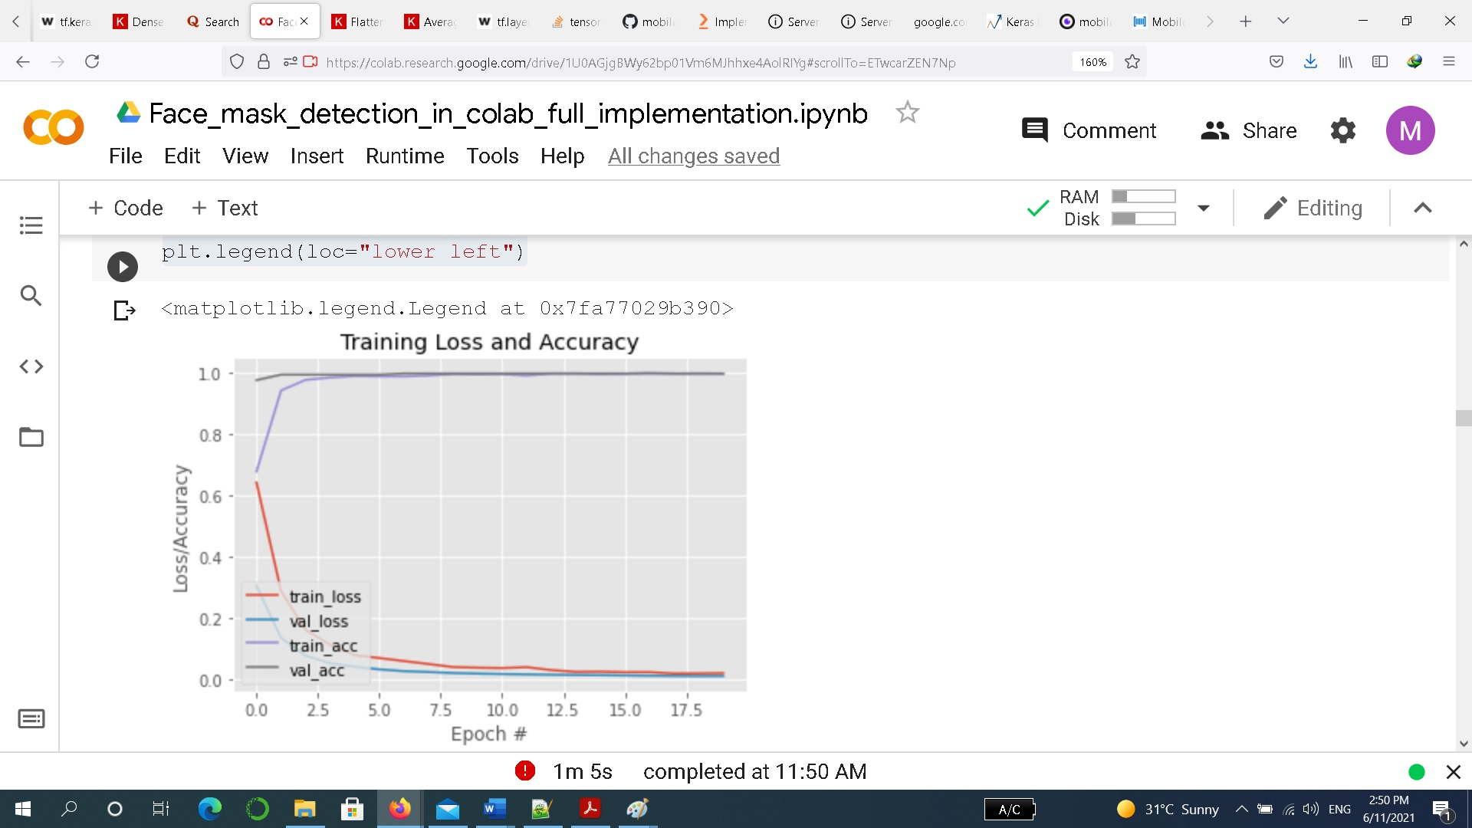
Screen shot of code:cont

Slide 16
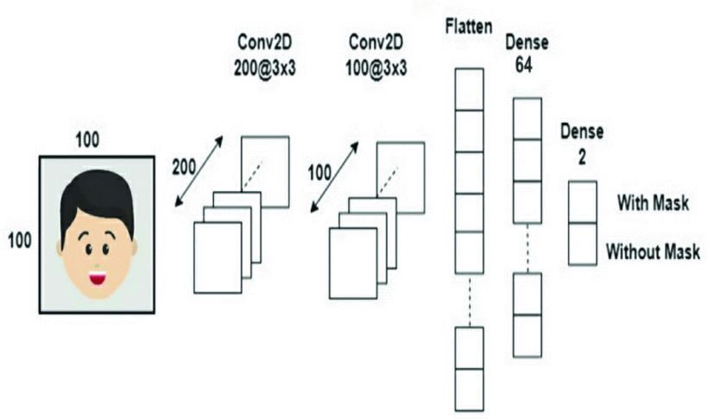
Pre processing:

Slide 17
Pre processing:cont.
baseModel = MobileNetV2(weights="imagenet", include_top=False, input_tensor=Input(shape=(224, 224, 3)))
headModel = baseModel.output
headModel = AveragePooling2D(pool_size=(7, 7))(headModel)
headModel = Flatten(name="flatten")(headModel)
headModel = Dense(128, activation="relu")(headModel)
headModel = Dropout(0.5)(headModel)
headModel = Dense(2, activation="softmax")(headModel)

Slide 18
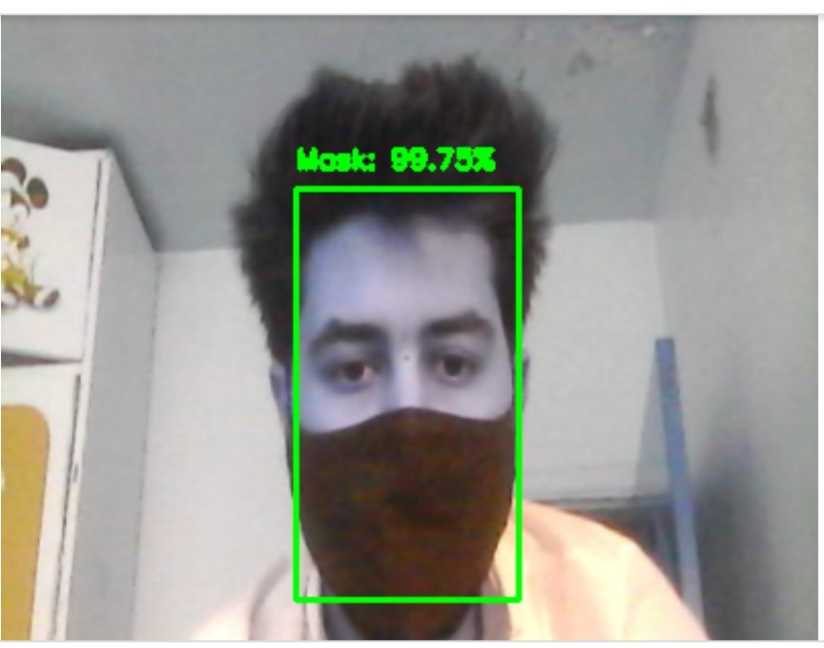
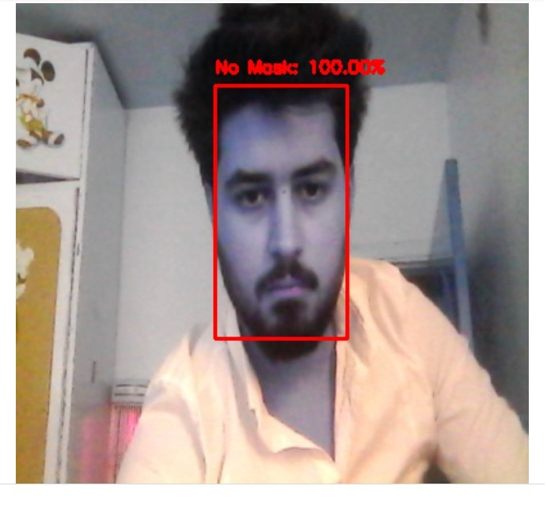
Screen shot of run final:

Slide 19
architecture:
A. TensorFlow
TensorFlow, an interface for expressing machine learning algorithms, is utilized for implementing ML systems into fabrication over a bunch of areas of computer science, including sentiment analysis, voice recognition, geographic information extraction, computer vision, text summarization, information retrieval, computational drug discovery and flaw detection to pursue research .In the proposed model, the whole Sequential CNN architecture (consists of several layers) uses TensorFlow at backend. It is also used to reshape the data (image) in the data processing.

Slide 20
architecture:cont.
B. Keras
Keras gives fundamental reflections and building units for creation and transportation of ML arrangements with high iteration velocity. It takes full advantage of the scalability and cross-platform capabilities of TensorFlow. The core data structures of Keras are layers and models . All the layers used in the CNN model are implemented using Keras. Along with the conversion of the class vector to the binary class matrix in data processing, it helps to compile the overall model.
C. MOBILE NET V2
MobileNetV2 is a general architecture and can be used for multiple use cases. Depending on the use case, it can use different input layer size and different width factors. This allows different width models to reduce the number of multiply-adds and thereby reduce inference cost on mobile devices.

Slide 21
Thanks for watching

